Slide 1

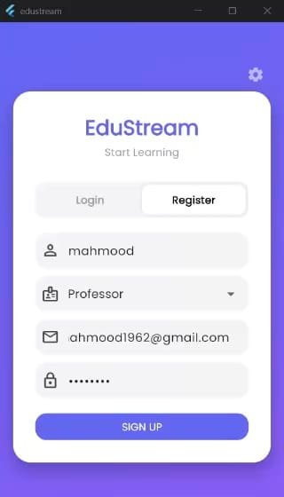
EduStream Enterprise
Hybrid Cloud Learning Management System
A next-generation Video Learning Management System (LMS) designed to address latency and scalability issues in traditional education platforms. This project implements a Hybrid Cloud Architecture using AWS Services.

Slide 2

Project Overview & Problem Statement
Executive Summary
Introduction
EduStream bridges Serverless computing (AWS Lambda) with dedicated deep-processing nodes (Amazon EC2) for video ingestion. It uses an Event-Driven Asynchronous Pipeline, buffering videos in Amazon SQS for 99.99% availability.
Legacy LMS architectures struggle with synchronous video processing and manual infrastructure management. EduStream adopts a Cloud-Native approach to overcome these vulnerabilities.
Problem Statement
Current academic video platforms face scalability crises (simultaneous uploads crash servers), latency (users wait for processing), and security risks (exposed API keys).

Slide 3
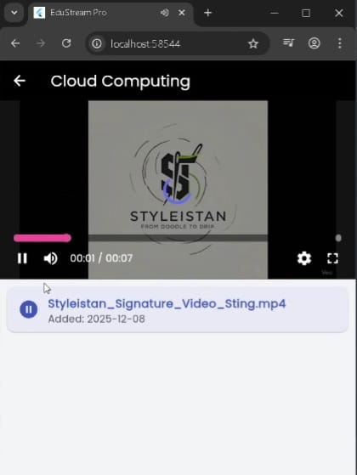
Aim & Objectives
1
Scalability
Implement Asynchronous Decoupling using Amazon SQS to handle traffic spikes effectively.
2
Hybrid Compute
Utilise Amazon EC2 for heavy computation tasks exceeding Lambda’s 15-minute limits.
3
Security
Implement AWS Secrets Manager for runtime credential fetching, eliminating hardcoded keys.
4
DevOps
Establish a fully automated CI/CD pipeline using GitHub Actions.

Slide 4
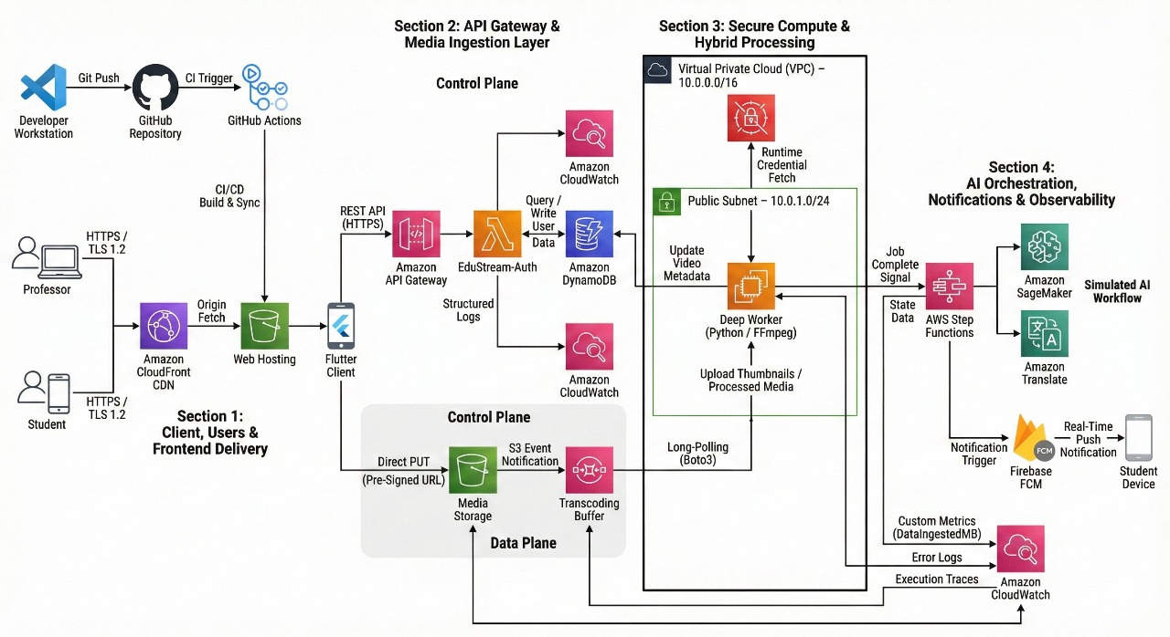
AWS Architecture Design
High-Level Architecture

Slide 5






AWS Architecture Design
High-Level Architecture
Public Cloud Layer
Handles Ingestion (S3), Auth (Lambda), and Buffering (SQS).
Client Layer
Cross-Platform Flutter Application (Web & Mobile) cached via Amazon CloudFront.
Secure VPC Layer
Custom isolated network hosting the EC2 Worker Node, protected by Security Groups.

Slide 6





System Logic Flow
Upload
User uploads video to Amazon S3 (Media Bucket).
Trigger
S3 creates event, sending it to Amazon SQS (Job Message).
Poll
EC2 Worker (Python) polls the queue and downloads the video.
Process
FFmpeg generates a thumbnail and updates DynamoDB.
Notify
EC2 triggers Firebase FCM, sending a push notification to the user.

Slide 7
Technical Stack Specifications
Frontend Framework
Flutter 3.34.0
Cross-platform UI toolkit for Web & Android.
Backend Logic
Python 3.9
Runtime for Lambda functions and EC2 Worker.
Compute Node
Ubuntu Server 22.04 LTS
OS for the Deep Worker Node (EC2).
Video Engine
FFmpeg 4.4.2
Multimedia framework for transcoding.
Infrastructure
CloudFormation YAML
Template format for IaC.
Notifications
Firebase (FCM) v16.1.0
Push notification delivery network.

Slide 8
AWS Service Cost & Usage Analysis
AWS Service | Resource Configuration | Unit Price | Monthly Usage (Est.) | Monthly Cost
Amazon EC2 | Instance: t2.small (Linux) | $0.023 / hour | 730 hours (24/7 run) | $16.79
EBS Storage | General Purpose SSD (gp3) | $0.08 / GB | 8 GB (Root Volume) | $0.64
Secrets Manager | Secret: EduStream/EC2/Credentials | $0.40 / secret | 1 Secret | $0.40
CloudWatch | Dashboard: EduStream-Ops | $3.00 / dashboard | 1 Dashboard | $3.00
CloudWatch | Custom Metrics | $0.30 / metric | 2 Metrics | $0.60
Amazon S3 | Standard Storage | $0.023 / GB | 5 GB (Media/Web) | $0.12
AWS Lambda | ARM Architecture | $0.20 / 1M reqs | 5,000 requests | $0.00 (Free Tier)
Amazon SQS | Standard Queue | $0.40 / 1M reqs | 10,000 requests | $0.01
DynamoDB | On-Demand Capacity | $1.25 / 1M writes | 1,000 writes | $0.01
Total Commercial Cost |  |  |  | ~$21.57 / month
Frontend Framework
Flutter 3.19.0
Backend Logic
Python 3.9
Runtime for Lambda functions and EC2 Worker.
Compute Node
Ubuntu Server 22.04 LTS
OS for the Deep Worker Node (EC2).
Video Engine
FFmpeg 4.4.2
Multimedia framework for transcoding.
Infrastructure
CloudFormation YAML
Template format for IaC.
Notifications
Firebase (FCM) v16.1.0
Push notification delivery network.

Slide 9
Implementation Steps
01
02
03
Frontend and devOps (flutter)
Infrastructure as Code (CloudFormation)
Hybrid Compute & Queue Configuration
Frontend deployed via Github Actions to an S3 static website bucket
Deployed the Network Layer automatically using a YAML Stack (infrastructure.yaml).
Deployed an Ubuntu EC2 instance as the "Deep Worker" and connected it to the SQS Buffering layer.
04
05
Backend Logic (Python & FFmpeg)
AWS Account & Security Setup
Implemented core logic as a Python Daemon on the EC2 instance, utilising boto3 and ffmpeg.
Ensured least-privilege access using LabRole and established Secrets Management.

Slide 10
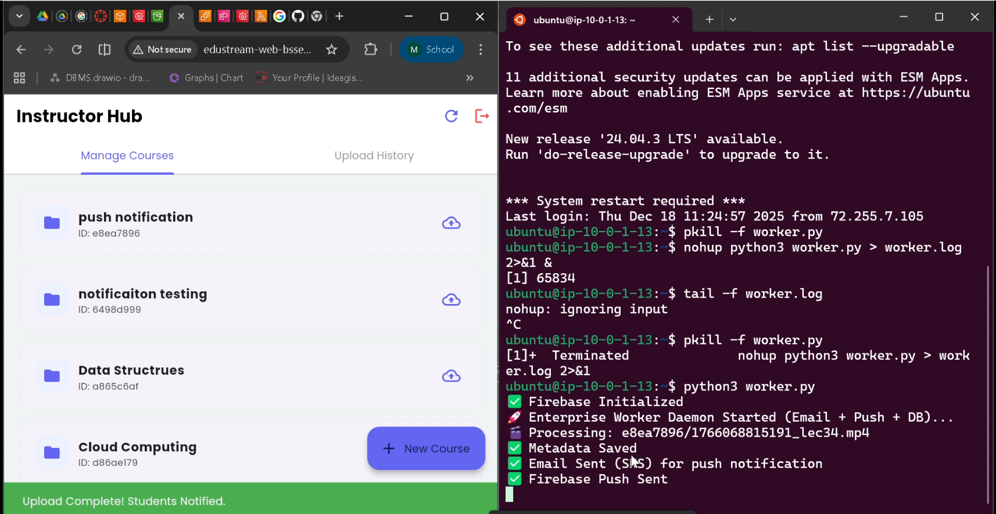
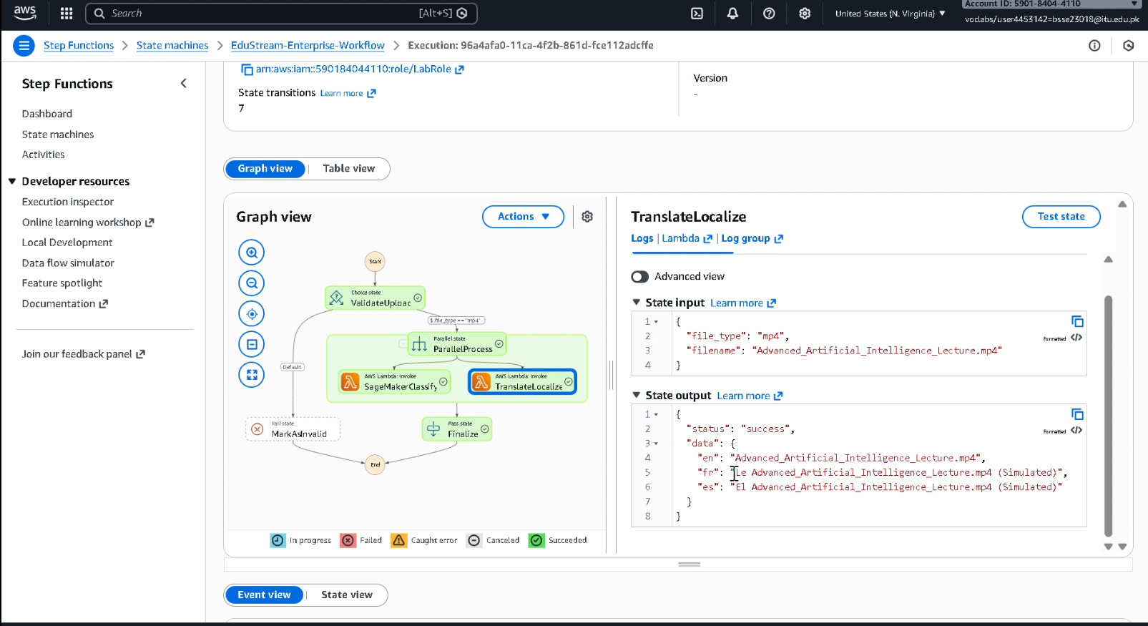
Testing Workflow & Results
End-to-End Test (The "Hybrid Bridge")
AI Orchestration Simulation
Validated the system by uploading a 4K video file, demonstrating successful asynchronous handoff.
Verified the logic flow using AWS Step Functions to simulate AI localization.

Slide 11
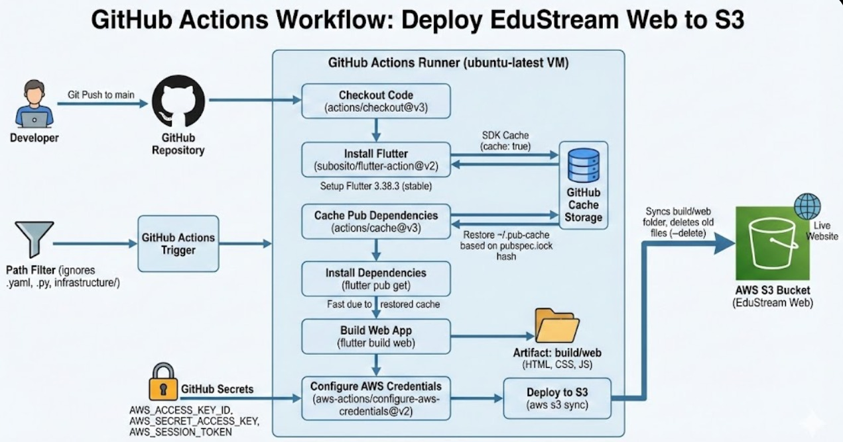
GitHub Action workflow

Slide 12
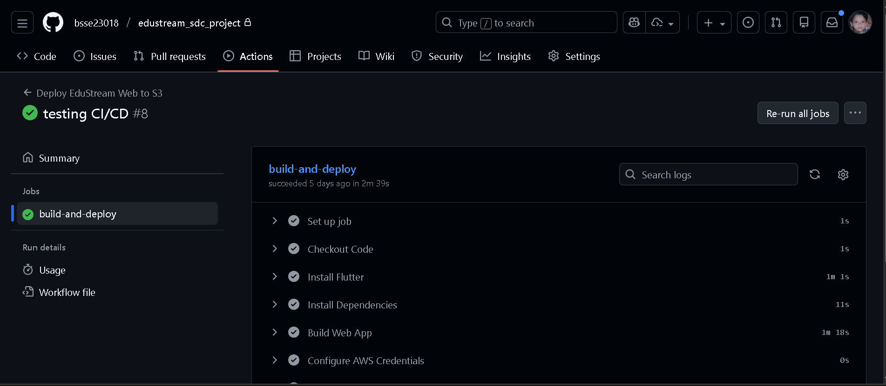
Frontend & DevOps (Flutter)
The frontend is deployed via GitHub Actions to an S3 Static Website bucket.

Slide 13
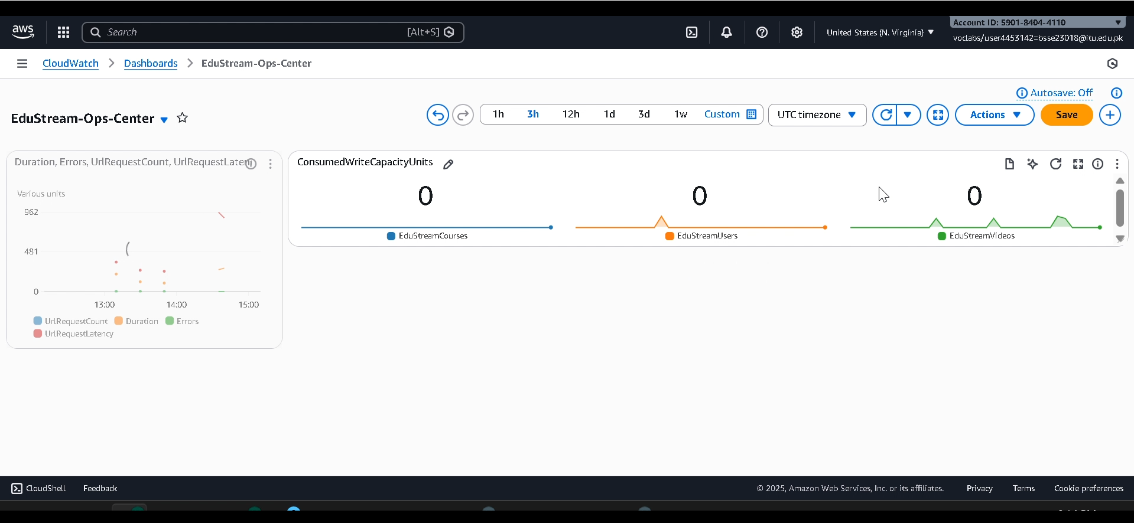
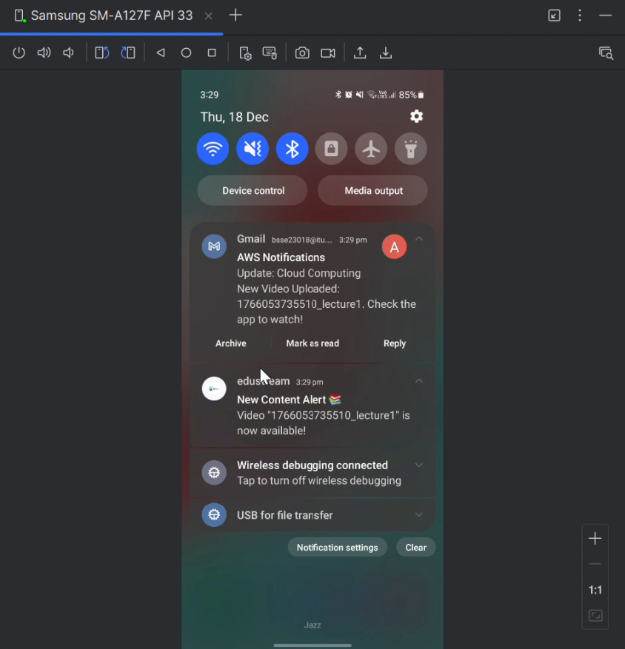
Monitoring & Final Output
Monitoring & Logs
Final Output
System health was tracked using a
custom CloudWatch Dashboard.
The end-user experience confirms the loop is
closed via Push Notifications.

Slide 14
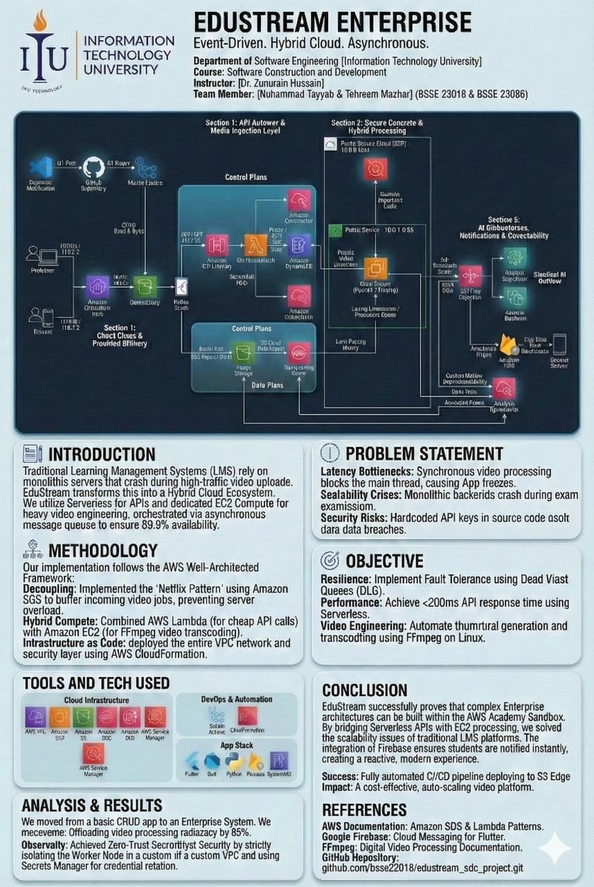
Poster
Scalable Video Processing & Serverless
Architecture for Modern Education
Decoupled Architecture: Implemented the "Netflix Pattern" using Amazon SQS to buffer video jobs and prevent server overload.
Hybrid Compute: AWS Lambda for fast, cheap API calls + Amazon EC2 for heavy FFmpeg video transcoding.
Infrastructure as Code: Full VPC and security deployment via AWS CloudFormation.

Slide 15

Conclusion & Cost Analysis
Successful Implementation
Achieved Objectives
Cost Efficiency
Achieved scalability (SQS), security (Secrets Manager), and automation (CloudFormation).
Total estimated commercial cost is approximately £21.57 per month, demonstrating efficient resource utilisation.
EduStream Enterprise successfully demonstrates complex, fault-tolerant cloud architectures within academic constraints.

Slide 16


